Slide 1
Comedy Presentation
YCEP2023{
By the funniest person in the world

Slide 2

This is a funny meme.
PR377Y_
Notes:
_funNY_

Slide 3
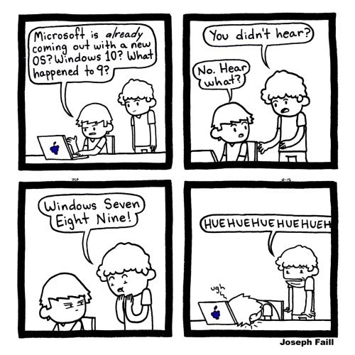
Funny jokes

Slide 4
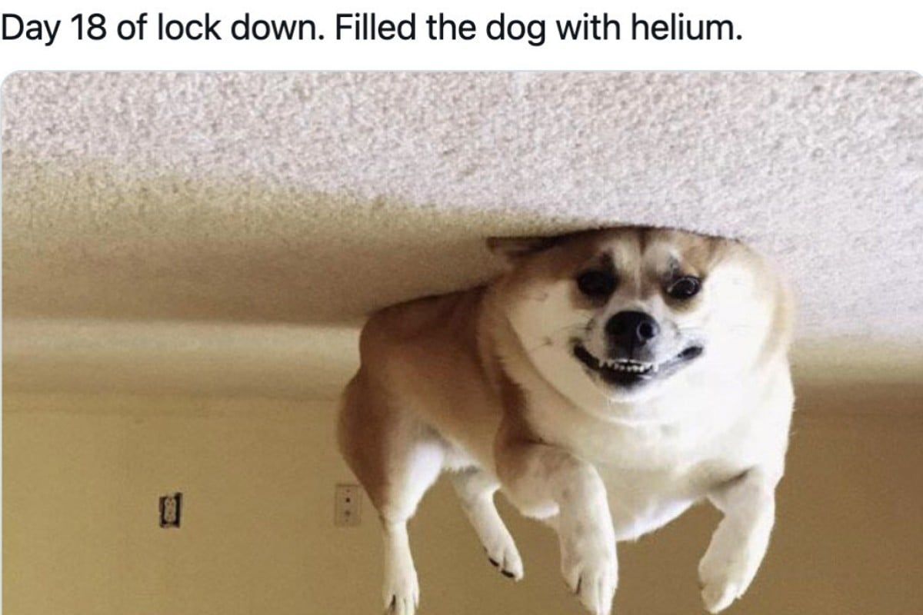
Funny jokes
_ N9L}

